Slide 1
Retrieving the Client’s IP and Port number
Faculty: Dr. Asif Uddin Khan

Slide 2
Retrieving the Client’s IP and Port number
Functions used
getpeername(): Gets the address of the client connected to the socket.
inet_ntop(): Converts the IP address from binary form to a human-readable string.
ntohs(): Converts the port number from network byte order to host byte order.

Slide 3
getpeername()
int getpeername(int sockfd, struct sockaddr *addr, socklen_t *addrlen);
sockfd: The file descriptor of the socket for which you want to get the peer's address.
addr: A pointer to a sockaddr structure where the peer's address will be stored.
addrlen: A pointer to a socklen_t variable that initially contains the size of the sockaddr structure and will be updated to the size of the address returned.

Slide 4
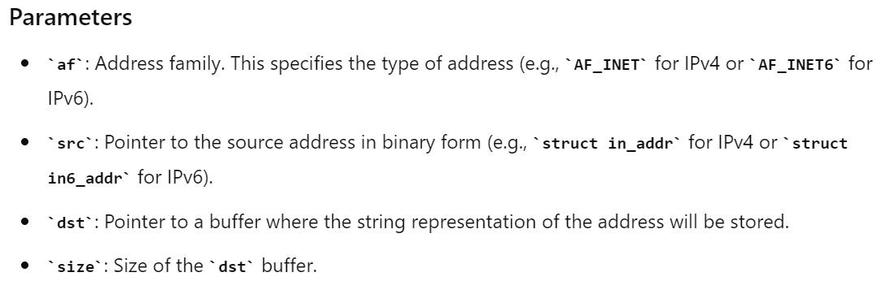
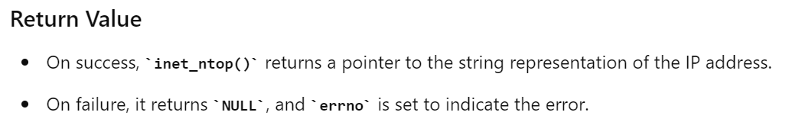
const char *inet_ntop(int af, const void *src, char *dst, socklen_t size);

Slide 5
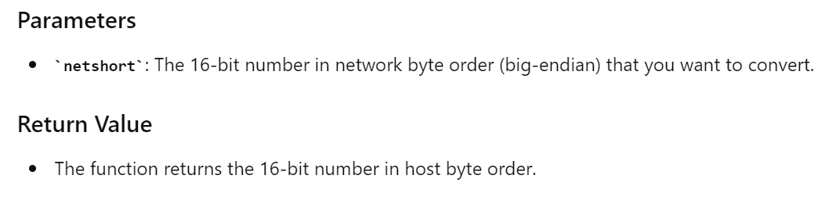
uint16_t ntohs(uint16_t netshort);

Slide 6
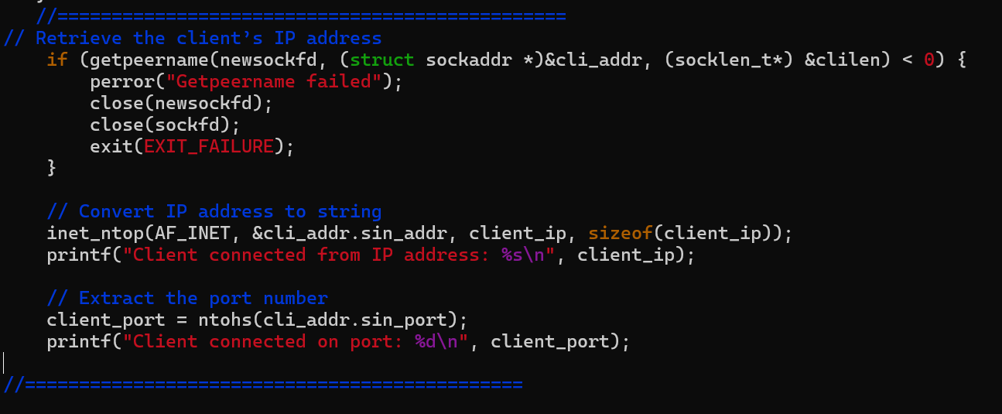
Example

Slide 7
Example: Retrieving the Client’s IP
char client_ip[INET_ADDRSTRLEN]; // declare in declaration section of the program
if (getpeername(newsockfd, (struct sockaddr *)&cli_addr, &clilen) < 0) {
perror("Getpeername failed");
close(newsockfd);
close(sockfd);
exit(EXIT_FAILURE);
}
// Convert IP address to string
inet_ntop(AF_INET, &cli_addr.sin_addr, client_ip, sizeof(client_ip));
printf("Client connected from IP address: %s\n", client_ip);

Slide 8
Example: Extract the Client’s port number
int client_port; // declare in declaration section of the program
// Extract the port number
client_port = ntohs(cli_addr.sin_port);
printf("Client connected on port: %d\n", client_port);

Slide 9
Assignment-4
1.
Write a TCP client server socket program in C for following task.
Client sends a message to the server
Server should print clients IP address and Port number of the client.
Server should print the message received from the client and also send another message to the client.
Client should print the message received from the server.
2. Connect the client and server in different server for the same task.
3. Modify the server code to take the IP address and port number from the user through command line argument.

